Slide 1
Modeling the Secondary Visual Cortex
By Hannah Machado
Direct Supervisor Dr. Odelia Schwartz
University of Miami
Notes:
Hello everyone, My name is Hannah Machado, I am a senior here at the University of Miami and I will be

Slide 2
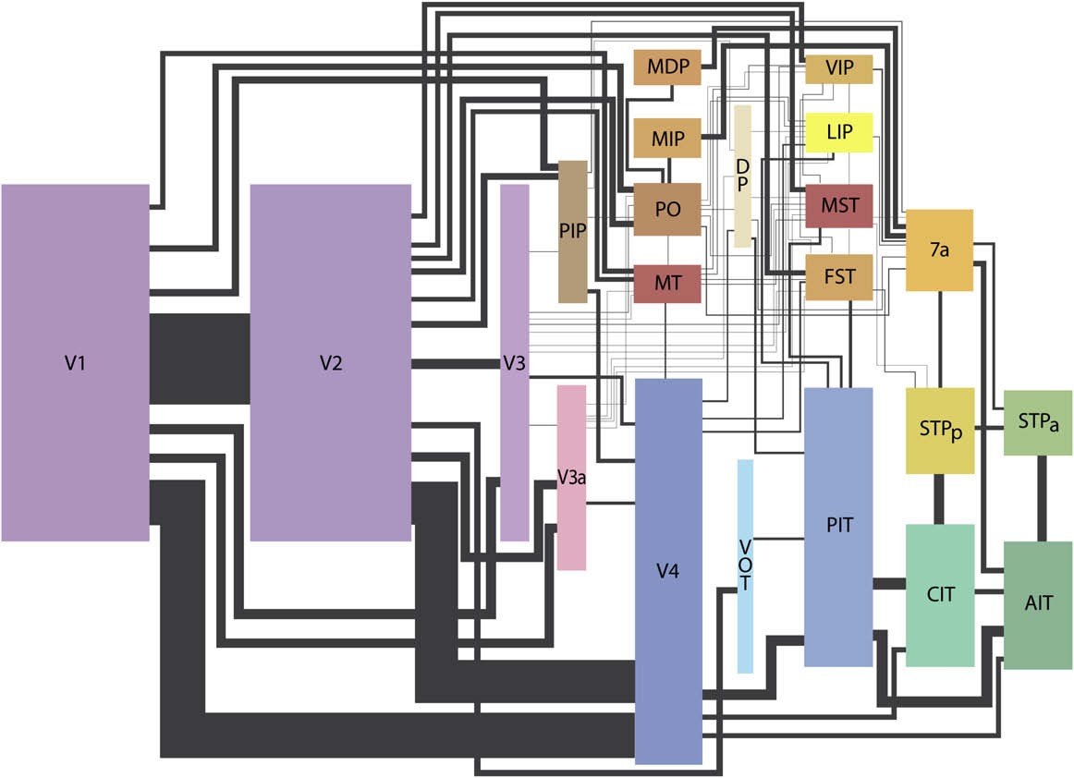
The Visual Hierarchy
Wallisch and Movshon 2008; After Felleman and Van Essen, 1991
Notes:
The way our brain makes sense of the world around us is through an intrinsic network of neurons that encode stimuli . When presented with a stimulus,
It goes from interpreting simple things like orientation to object recognition
Much is known about visual processing in V1
In this graph, the sizes of the rectangles are proportional to the surface area in the brain. Even though a lot is known about what goes on in V1, very little can be concluded on V2

Slide 3
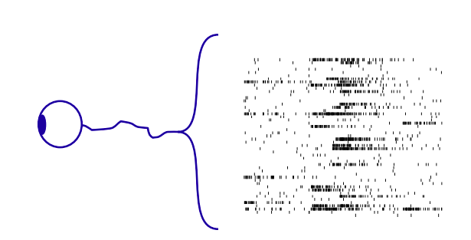
What your brain “sees”
Stimulus → Neurons → response
Notes:
What our brain ”sees” when presented with a stimulus is essentially a series of spikes that are encoded into stimuli and then decoded by the neurons to interpret the world around us.
each vision cell’s receptive field is activated when light hits a tiny region in the center of the field and inhibited when light hits the area surrounding the center.
Begins with light passing the cornea and the retina, through the LGN (lateral geniculate nucleus)
They prefer stimuli in the shape of bars or edges and those at a particular angle (orientation). Further studies have shown that different cells prefer edges at different angles or edges moving in a particular direction.

Slide 4
V1 vs. V2
Little is known about role of V2 in visual processing
Neuron specificity not clearly defined
An injury in that area significantly affects the ability to perform complex spatial tasks (Merigan et al., 1993)
1st cortical area of visual processing
Neurons are driven by orientation
Deconstruct a scene based on spatially localized oriented components
Goal → build a model that can explain V2 data
Notes:
No specific stimuli has been found to trigger the neurons in V2

Slide 5
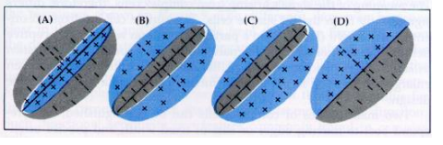
Receptive fields
Biologically speaking: regions on the visual field upon which a stimulus can modify the firing of the neuron and obtain a response
Computationally speaking: a filter that captures the stimulus specifications and generates responses accordingly.
(From Nicholls et al., 1992)
Simple cell | • Elongated or rectangular with activated or deactivated regions. • Selective for image orientation
Complex cell | • Rectangular but large receptive fields that respond to a specific stimulus anywhere within the field. • Selective for orientation and direction
Notes:
Complex cells
Cares that it is vertical, not that it has positives and negatives
A complex cell would respond to all of these stimulus.

Slide 6
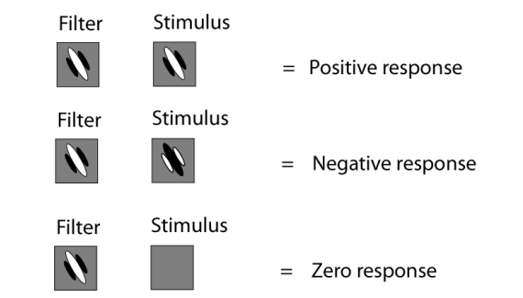
Linear filter
The response = dot product of filter with stimulus
Notes:
Here we have an example of a linear filter, where essentially a stimulus can produce a positive, negative, or neutral response.
The response in this case is the dot product of the filter with the stimulus. So, for example, the filter will recognize a black, white black stimulus as a positive response and a white black white stimulus as negative, while a blank stimulus wont produce any response.

Slide 7
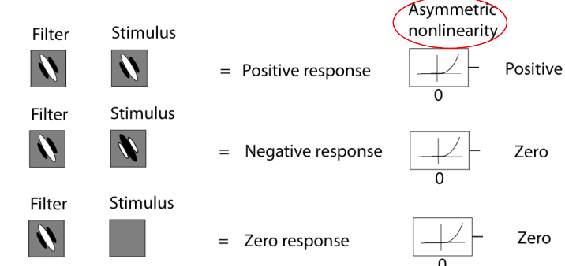
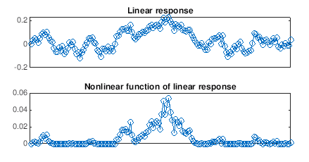
Nonlinearity
Nonlinearity sets the negative stimulus to zero
Time
Notes:
Some things cannot be explained linearly, so Nonlinearity allows you to learn more complex structures and take a step further
Its like untangling the space. Things are not linearly separable in beginning, but if you sort them nonlinearly, you might get to a point where you can separate images easily
In this case, it sets the negative filter responses to zero (firing rates are positive). To the left we have a comparison of temporal stimulus, firing rate over time, and we can see that the nonlinear function highlights the –eak of the stimulus

Slide 8
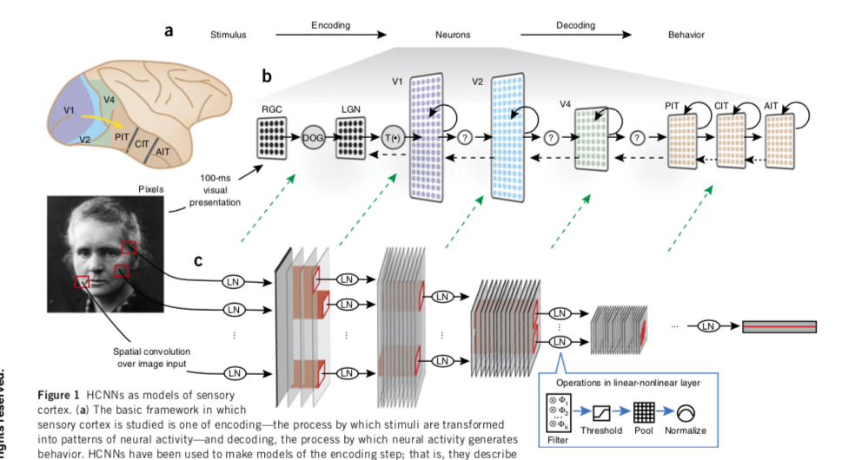

Explain V1 is well understood but V2 not so much
(Yamins, Dicarlo, 2016)
Notes:
encoding—the process by which stimuli are transformed into patterns of neural activity—and decoding, the process by which neural activity generates behavior.
each of whose layers are made up of a linear-nonlinear (LN) combination of simple operations such as filtering, thresholding, pooling and normalization. The filter bank in each layer consists of a set of weights analogous to synaptic strengths. Each filter in the filter bank corresponds to a distinct template, analogous to Gabor wavelets with different frequencies and orientations; the image shows a model with four filters in layer 1, eight in layer 2, and so on.

Slide 9
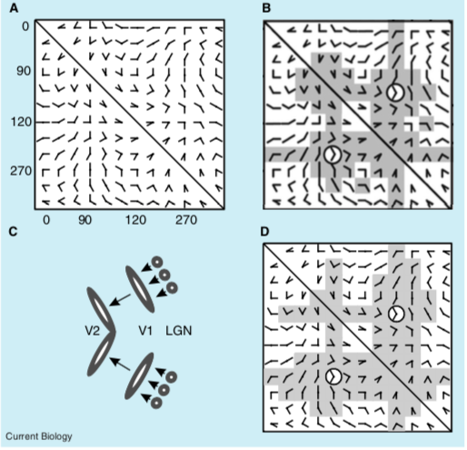
Ito and Komatsu
Responses of V2 neurons to pairs of angled lines predicted from responses to the individual line components.
Interpreted as the sum of responses from one or more V1 cells (orientation selective)
Simple linear models cannot explain these results, there is nonlinearity
Chosen stimuli is often based on guesses that make up fundamental components of a visual scene to perform tasks such as object recognition and contour segregation
(adapted from Ito, M., and Komatsu, H., 2004 )
Notes:
(A) Angle stimuli, consisting of two line segments, used by Ito and Komatsu [9] to study the selectivity of V2 neurons. The orientation of one line segment varies along the rows and the orientation of the other line segment varies along the columns. (B) The pattern of responses for an example neuron. Circles surround the stimulus that evoked the maximal response, and stimuli that evoked more than half this maximum are shaded in gray. (C) Our model V2 neuron sums the responses from two orientation-selective V1 neurons that sum the inputs from LGN cells with center-surround receptive fields [11]. (D) Predicted response from our model neuron to the stimulus set. Like the example V2 neuron, the model neuron responds to angle stimuli containing ori- ented line segments that match the pre- ferred orientation of either of the two V1 input neurons.

Slide 10
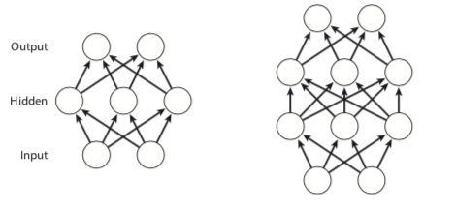
Deep neural networks
Shallow Feedforward
Deep Feedforward
(Kriegeskorte et al., 2015)
Depth is important to represent many complex functions more concisely →
fewer units and weights than shallow nets and support vector machine
Notes:
Deep learning refers to a subset of the concept of machine learning, it has become very popular the last few years
Lets say hope is for second layer to keep up
The question is What parameters we need to make the assigned layer recognize that pattern
Learning → hopefully it generalized into all types of data

Slide 11
Unsupervised Approach
Does not require labels for a network to learn a representation
Can find compressed representations of Natural images
Notes:
Hypothetically speaking, early areas: you don’t need supervision
There is no starting place, anything I possible
The data does not have to be labeled
Finding structure in the data without labels

Slide 12
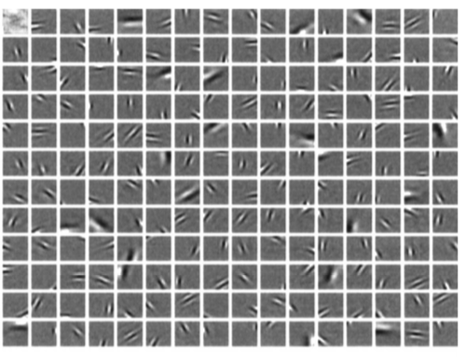
Sparse coding
Class of unsupervised method for learning sets to represent data efficiently
Understand the response properties of V1 simple cells by considering their relationship to the statistical structure of natural images in terms of efficient coding
Assumes responses are non gaussian
(Olshausen, Fiels, 1996)
Successfully explained many receptive field properties in V1, but nothing is concluded about V2
Notes:
The receptive fields in V1 simple cells can be characterized as spatially localized and oriented.
In an attempt to understand the response properties of such visual neurons, is to consider their relationship to the statistical structure of natural images in terms of efficient or sparse coding.
This figure is the result of an attempt to train an unsupervised learning algorithm with natural images to produce receptive fields with similar properties as V1.
No one has succeeded in developing a full set that contains al the properties of a simple or complex cell.
Sparse coding aims to find a sparse representation of the input data in the form of a linear combination of basic elements as well as those basic elements themselves.
The image is the result of a learning algorithm that attempts to find sparse linear code for natural scenes to develop a complete family of localized, oriented receptive fields.
The resulting sparse image code provides a more efficient representation for later stages of processing because it possesses a higher degree of statistical independence among its inputs
Again going back to the idea that V1 is quite well understood and can be well represented, whereas nothing is concluded on V2 neurons.
This image shows the learned basis function scaled in a magnitude that each function fills the grey scale, and zeroes always represented with the same grey level
Sparsifying makes units more selective in which aspects of stimulus they respond to.
It’s a way to optimize the data and find such the representation is minimized and sparse enough

Slide 13
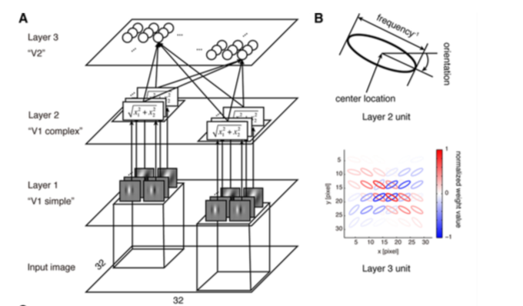
Hosoya et al.
hierarchical sparse coding model of natural images
• Layer 1 representing model V1 simple cells, Layer 2 representing model V1 complex cells, and Layer 3 representing model V2 cells
(Hosoya et al., 2015)
Notes:
2 layers, goes through a linear combination then nonlinear then V2 again
terials and Methods). B, Visualization scheme. A Layer 2 unit is drawn as an ellipse with the orientation and the size proportional to the orientation and the inverse of frequency of the underlying Gabor filters, respectively

Slide 14
Supervised Learning
Has objectivity and is task based
Requires input patterns and associated desired outputs included in the data
Most “successful” models have been supervised
Notes:
Trained on a task, its discriminating images
You have a starting point, its good to be able to improve if anything is wrong
The sample has been tagged with labels, we know what we are dealing with
The “successful” is in quotations because they have been efficient in object recognition, but that does not necessarily mean that its what the brain does.

Slide 15
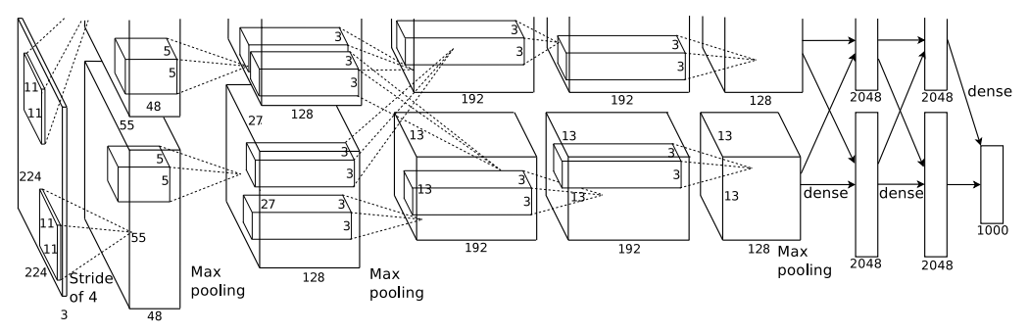
Krizhevsky’s approach
(Krizhevsky et al., 2012)
Convolutional layers with nonlinearities in between
Second layer is essentially getting a larger receptive field
End: a few fully connected
Notes:
first year where a CNN was used to achieve a top 5 test error rate of 15.4%
Fairly simple model, 5 layers
max-pooling layers, dropout layers, and 3 fully connected layers.
Main Points
Trained the network on ImageNet data, which contained over 15 million annotated images from a total of over 22,000 categories.
Used ReLU for the nonlinearity functions (Found to decrease training time as ReLUs are several times faster than the conventional tanh function).
Used data augmentation techniques that consisted of image translations, horizontal reflections, and patch extractions.
Implemented dropout layers in order to combat the problem of overfitting to the training data.
Trained the model using batch stochastic gradient descent, with specific values for momentum and weight decay.
Trained on two GTX 580 GPUs for five to six days.
Why It’s Important
The neural network developed by Krizhevsky, Sutskever, and Hinton in 2012 was the coming out party for CNNs in the computer vision community. This was the first time a model performed so well on a historically difficult ImageNet dataset. Utilizing techniques that are still used today, such as data augmentation and dropout, this paper really illustrated the benefits of CNNs and backed them up with record breaking performance in the competition.

Slide 16
Comparison of both systems
Unsupervised system:
→ Good for making discovery in data sources
→ Interesting for general explorations of deep learning algorithms
Supervised:
→ Attain specific goals and objectives while encouraging optimization in machine vision
→ Its been successful lately
Notes:
People have assumed unsupervised more general purpose. Get data that is more general and then task based. Top down or bottom up. There might be some unsupervised learning in the beginning but then eventually the task becomes
Were asking what the brain is actually using, building these models to compare to brain

Slide 17
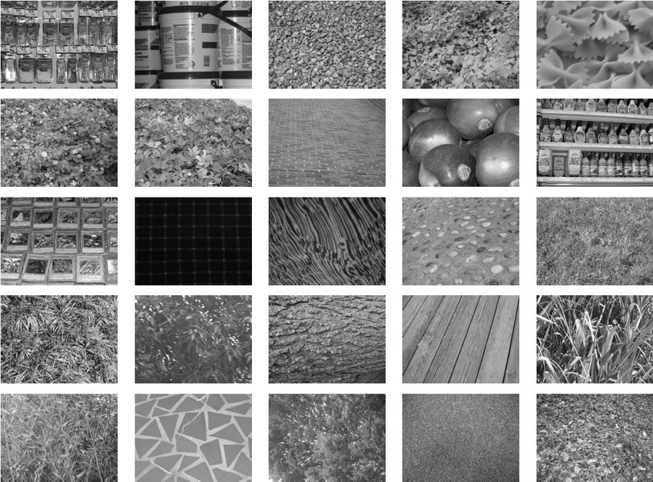
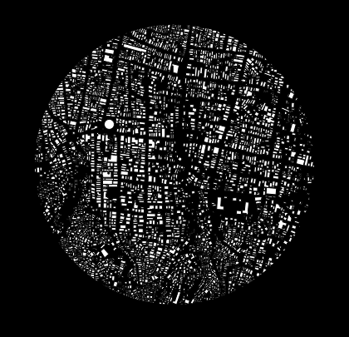
What’s next?
Run all these stimuli with Hosoya model and a supervised learning network
Compare the results to what the brain actually responds to
Show images to the brain and data to the model, how well you can predict responses
fMRI
Biology electrophysiology.
Multiple data types:
Angles
Texture
Figure ground
(adapted from Ito, M., and Komatsu, H., 2004 )
Notes:
Maybe need more versions of unsupervised

Slide 18
For thought…
Many advancements have been recently made in object recognition and computational models
But are they similar to what the brain actually does?
Notes:
How do all these systems combine to produce the vivid images of solid objects that we perceive?
The brain extracts biologically relevant information at each stage and associates firing patterns of neuronal populations with past experience.

Slide 19
Questions?
Thank you!

